Slide 1
Team 53 - PHAZE
Client: Chet Udell
Project: Evaporometer
Team Members:
Alessandro Lim, Jaydeep Rotithor, Touku Cha

Slide 2
Introduction
Project description
Evaporometer: Iot Weather Station
Open source
Collecting data and transmitting it
Visualize the data
OPENs Lab
A team under College of Agricultural Science
Working on many different projects
Aim to create open-source and cheap alternatives to data sampling
Team members on this project: Marissa Kwon, Manuel Lopez, and Thomas DeBell
Location -
H.J. Andrews Research Forest
Oregon State University

Slide 3
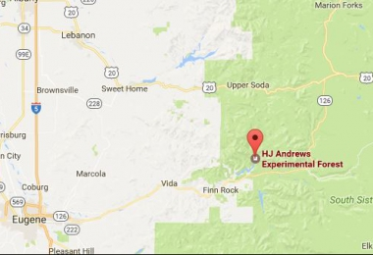
Location of H.J Andrews Research Forest
Source: H.J. Andrews Research Forest

Slide 4
Overview of Project
Hardware
Software
Geoviz

Slide 5
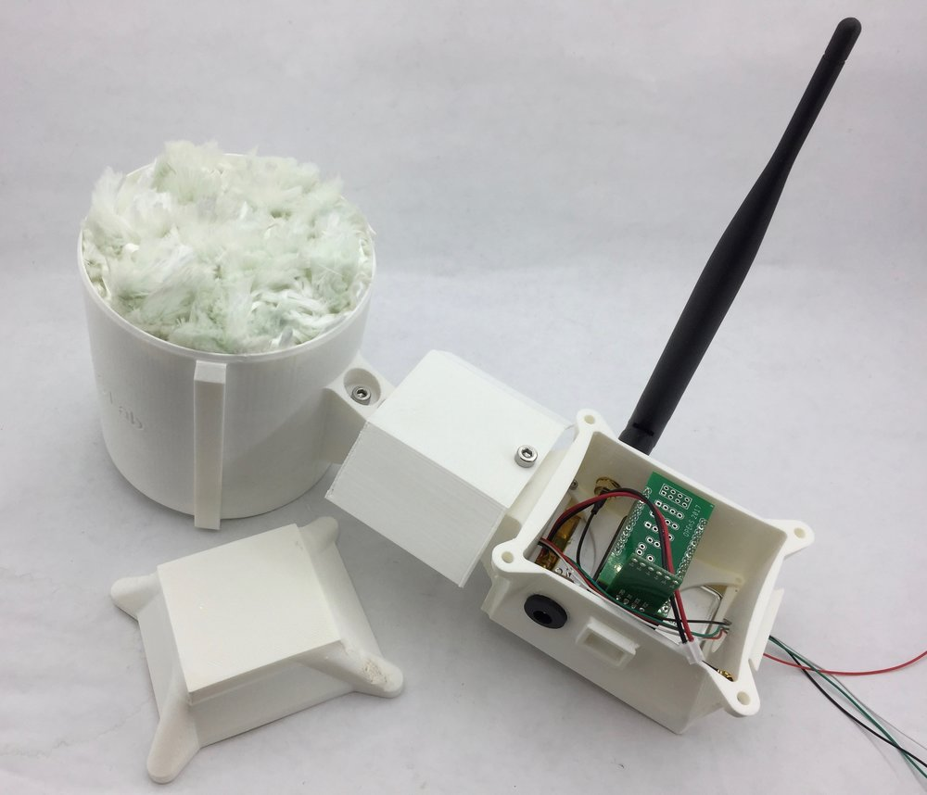
Evaporometer
Modular, open-source, Internet of Things Weather Station.
Deployment
Usage:
Data Collection
Temperature, humidity, rainfall, three forms of light (Infrared, spectrum, and Albedo
Parts
Load Cell
Enclosure - CAD
Microcontroller w/ Sensors
Source: Open-Sensing.org

Slide 6
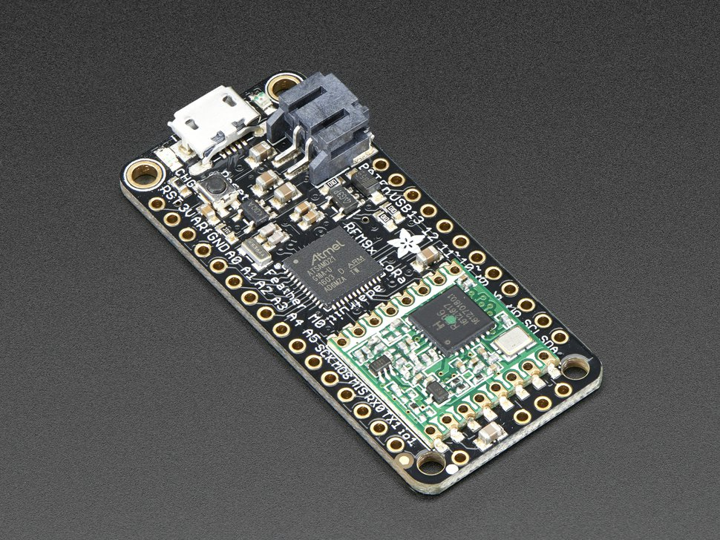
Microcontroller
Adafruit Feather M0
Previously used Feather 32u4, but not powerful enough
32KB RAM, compared to 2KB RAM in 32u4
Same price
Using LoRa to transmit the data
Low power, long range radio
Can transmit data up to 2KM.
SD card as local storage
Source: Adafruit

Slide 7
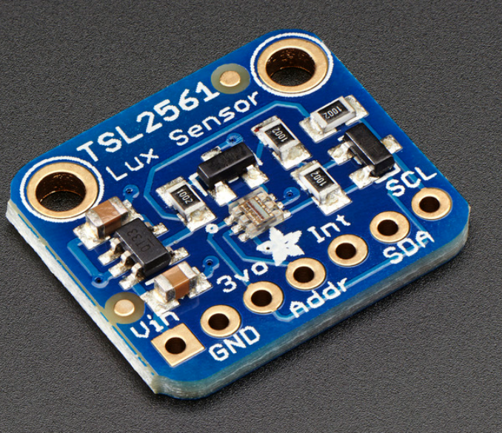
Sensor
Using the same sensors from last year
1 temperature and humidity sensor
1 load cell to measure rainfall
Now with 2 light sensors
Addressing issues resolved with new TSL2561 Lux sensors
Used in measuring general light conditions and the Albedo effect.
Source: Adafruit

Slide 8
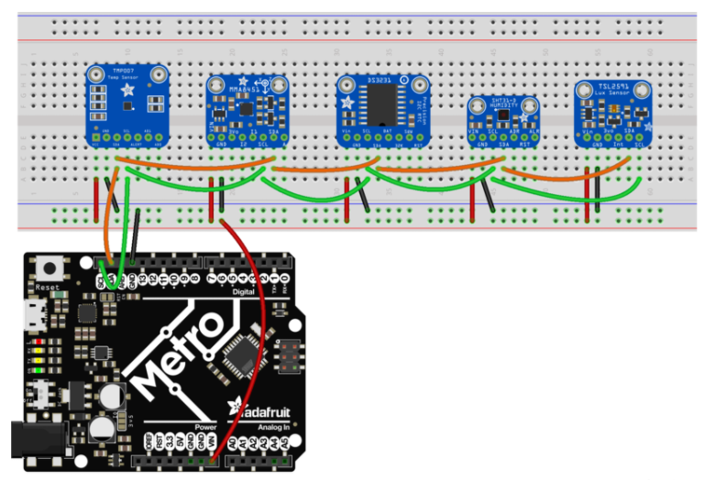
I2C Addresses
Source: Adafruit

Slide 9
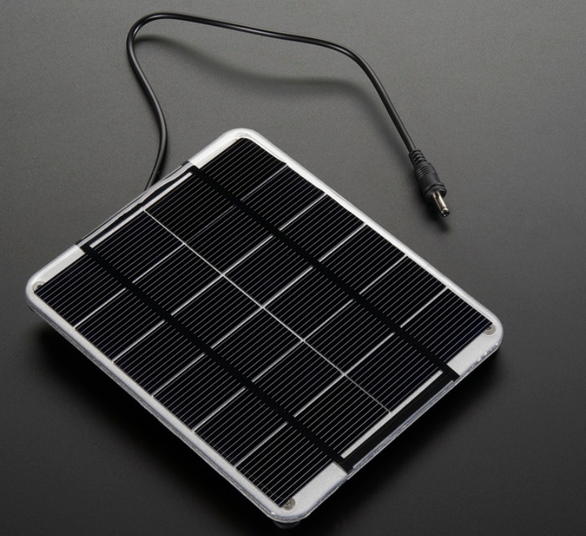
Solar Charging
Why?
Self-sufficient
Cost
Reliability compared to other renewables
Plans
Budget
Planning
Deployment
Source: Adafruit

Slide 10
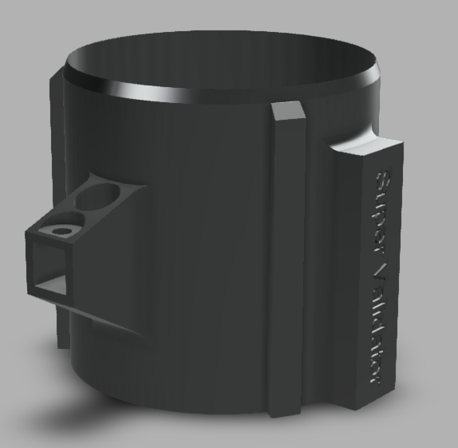
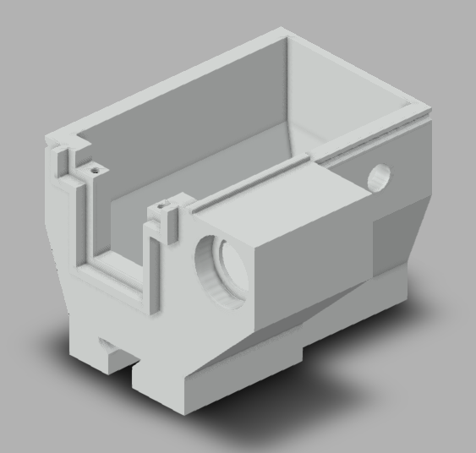
Other hardware
Source: https://github.com/OPEnSLab-OSU/Evaporometer

Slide 11
Current Codebase
OPENs Lab team code
On github
Our code
Forked from OPENs Lab’s team code
Our tasks
Modify the code to handle 20 evaporometers
Adding code to visualize the data

Slide 12
Database
Google Drive as the main data storage
Currently use 1 file to store all the data
Might need to have one file for each evaporometer
15GB free space
mongoDB for the visualization
Free, open-source, can be hosted locally
No need for SQL, table is mostly independent
Professor Bo talked about using this.

Slide 13
GIS
What it is
A GIS, or Geographic information system, is a modeling system that is used to manipulate geographic data
Used to provide structure to maps
A GIS typically consists of spatial information and descriptive information. The spatial information describes where an item is located(its coordinates). The descriptive information contains information such as the name of the item, its size, and its type(e.g. A school, a forest, etc)
Will be working on this with professor Bo Zhao, from the college of earth, ocean, and atmospheric sciences.
How we will use it
To create an accurate map with the necessary features
To help provide the reader with an accurate location for the data being plotted

Slide 14
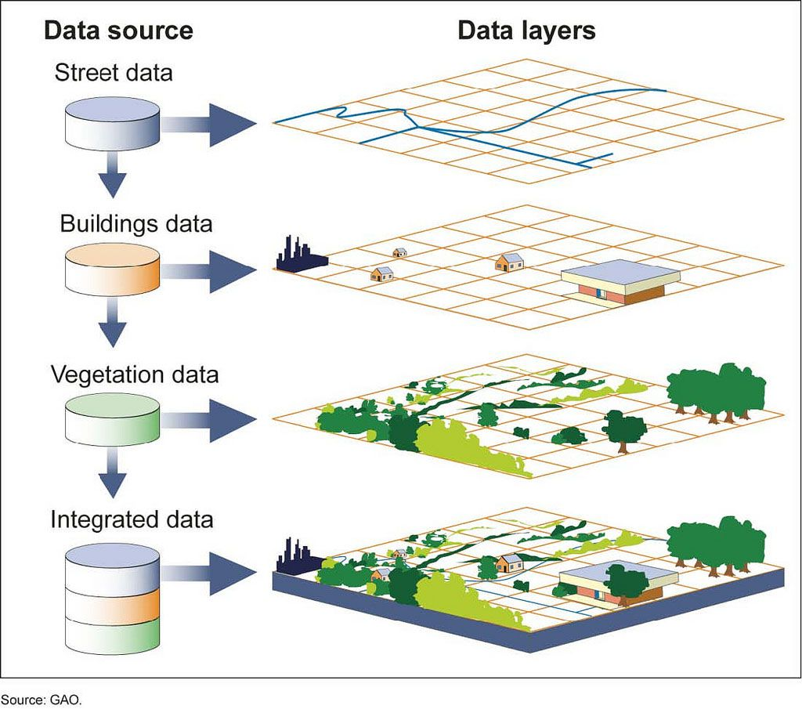
GIS
Source: National Geographic

Slide 15
Data Collection
How data is collected?
Sensors, pre-programmed into the Feather to start up and scan for information.
Stored in variables
Call PushingBox API function to send data to Google Sheets
PushingBox for free 1000 notifications/calls

Slide 16
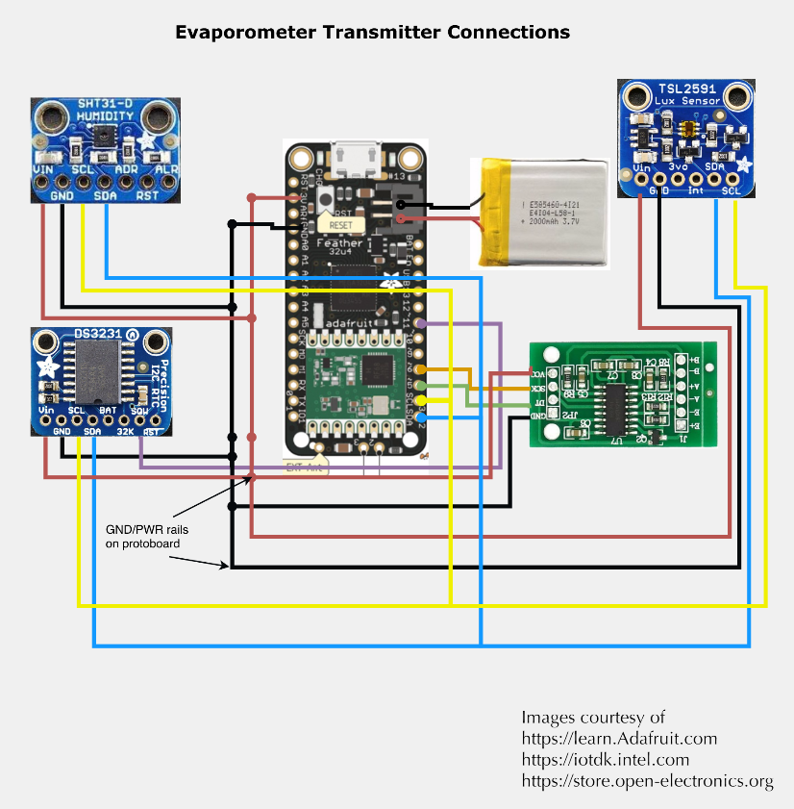
Overview of Software
Feather M0 with Lora
Sensors (I2C addressing)
SHT31-D
TSL2591/TSL2561
RTC
DS3231
Battery
LiPoly and Solar
EEPROM
SD
Issues

Slide 17
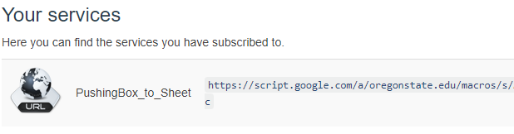
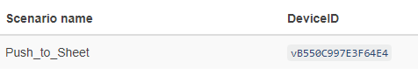
Overview of Software Cont.
Entire Process
Data Collection
Data Storage
PushingBox
Google Drive
GIS

Slide 18
Web Development
What we are using
Webstorm, Typora
Webstorm is an IDE with several useful extra features. It contains built-in version control, code refactoring, a built in code compiler and debugger, and the ability to synchronize code. It also updates websites in real-time, so it is not necessary to compile code after each change.
Typora is a text editor with a few additional features, such as special characters for bold and italics, and the ability to enter mathematical equations
What we are using it for
Webstorm : Used for the development of actual web maps.
Typora : Used to modify text files, such as GeoJSON files, which contain coordinate information on objects.

Slide 19
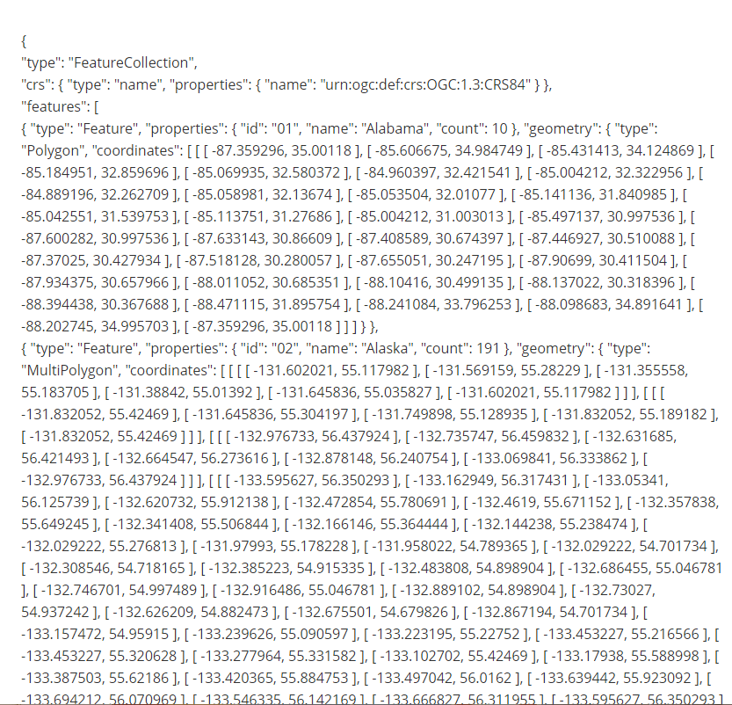
Web Development
Example of GeoJSON file:

Slide 20
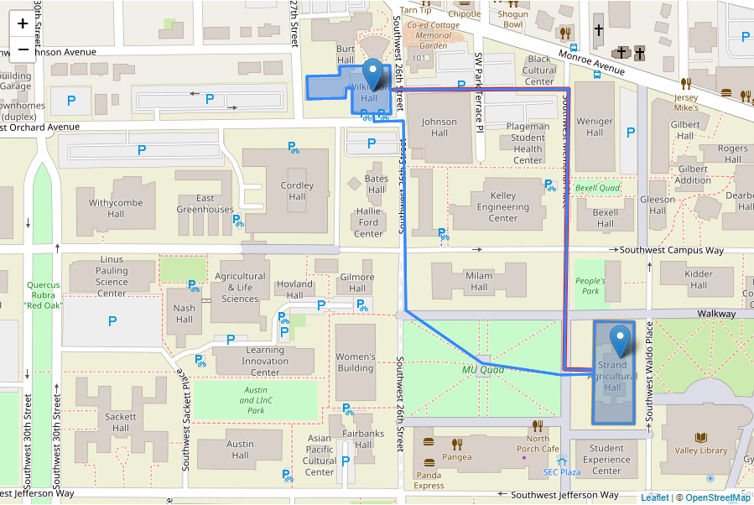
Web Development(cont’d)
Example of web map generated using Webstorm:

Slide 21
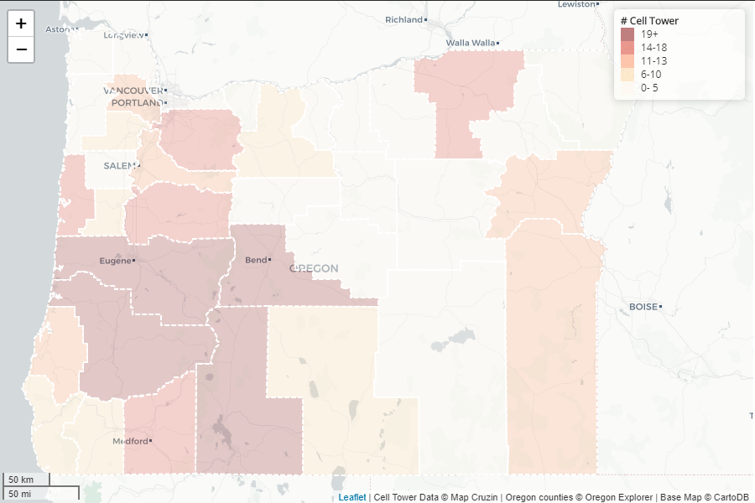
Web Development(cont’d)
Example of interactive web map generated using Webstorm:

Slide 22
Stumbling Blocks
Issue:
-Chet has been missing from all of our assignment meetings.
- Communication with Chet
- The geoviz was added into the project 8 weeks into the term
Solution:
We have been working with his team members in team meetings and basecamp.
We were able to sort out the Geoviz with Professor Bo.

Slide 23
Goals next Term
Alessandro
Set up mongoDB, discuss about where to host the database.
Receiver code: making sure no data loss when receiving from 20 evaporometers.
Receiver code: Being able to tell which evaporometer is down.
Receiver code: sending notifications or warning if an evaporometer is down
Blog posts.
Stretch goal: Push notification to phone or tablet if one evaporometer is down.
Jaydeep
Create an online web map
Use socket.io to set up the web map to accurately display real-time data
Make the map interactive, so that the user is able to view plotted data in different places
Log my progress in blog posts

Slide 24
Goals Cont.
Touku
Update transmission code: RSSI, average samples, tarring
Make changes to PushingBox: comma separated values
Have the solar charging bill of materials for Chet to begin ordering parts
Blog posts for OPENs Lab

Slide 25
Conclusion
Development on the project will begin by Winter Term.

